Slide 1
ARC – Excel

Slide 2
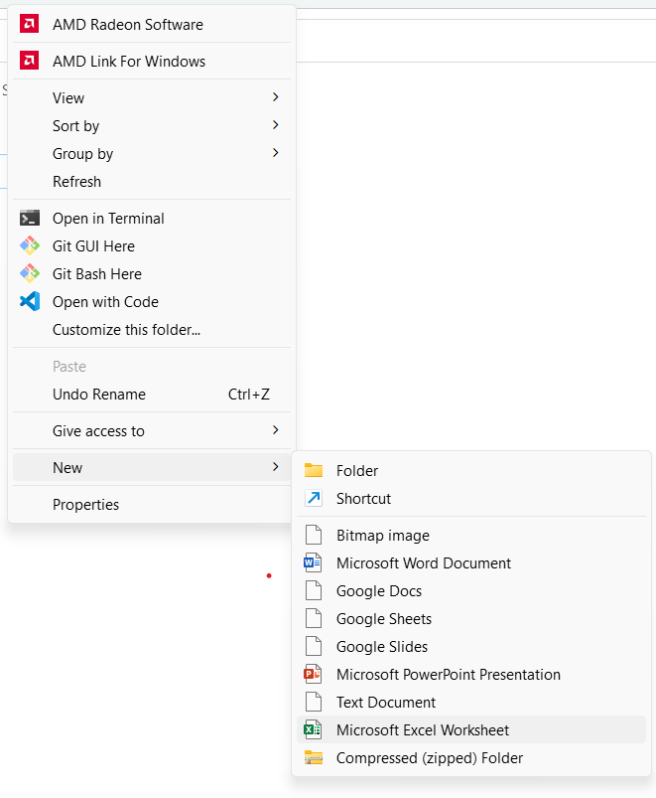
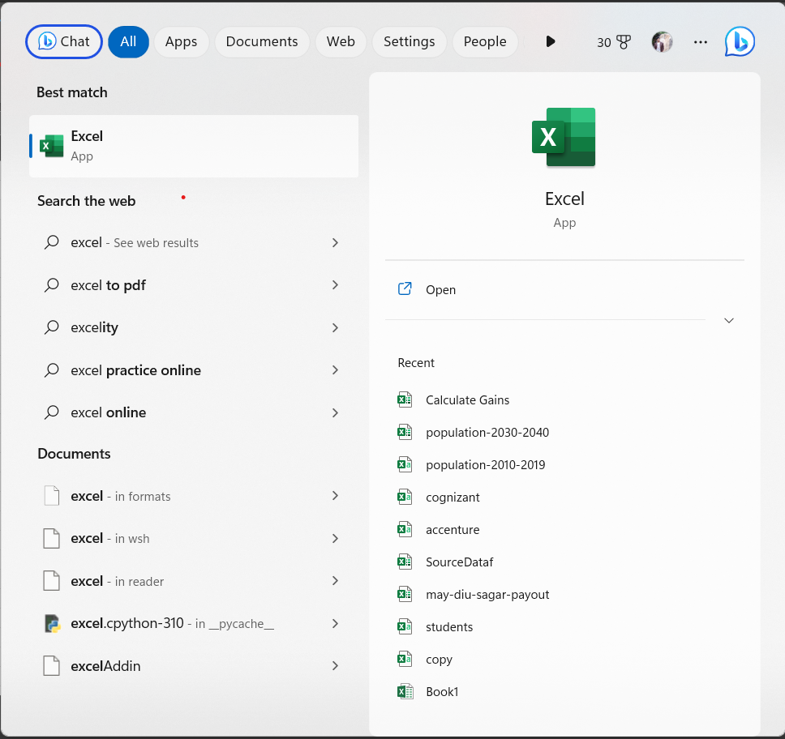
How to open

Slide 3
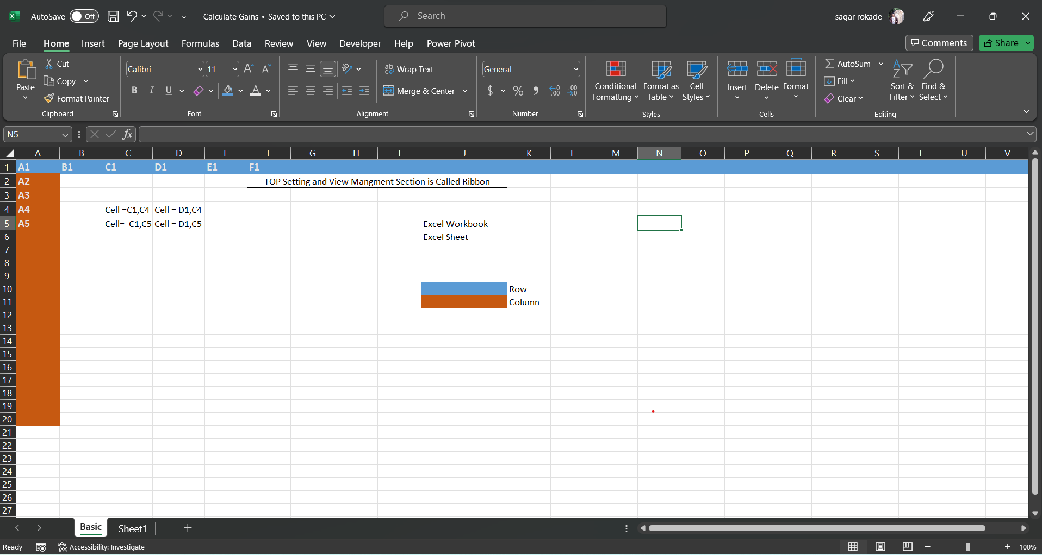
New Workbook

Slide 4
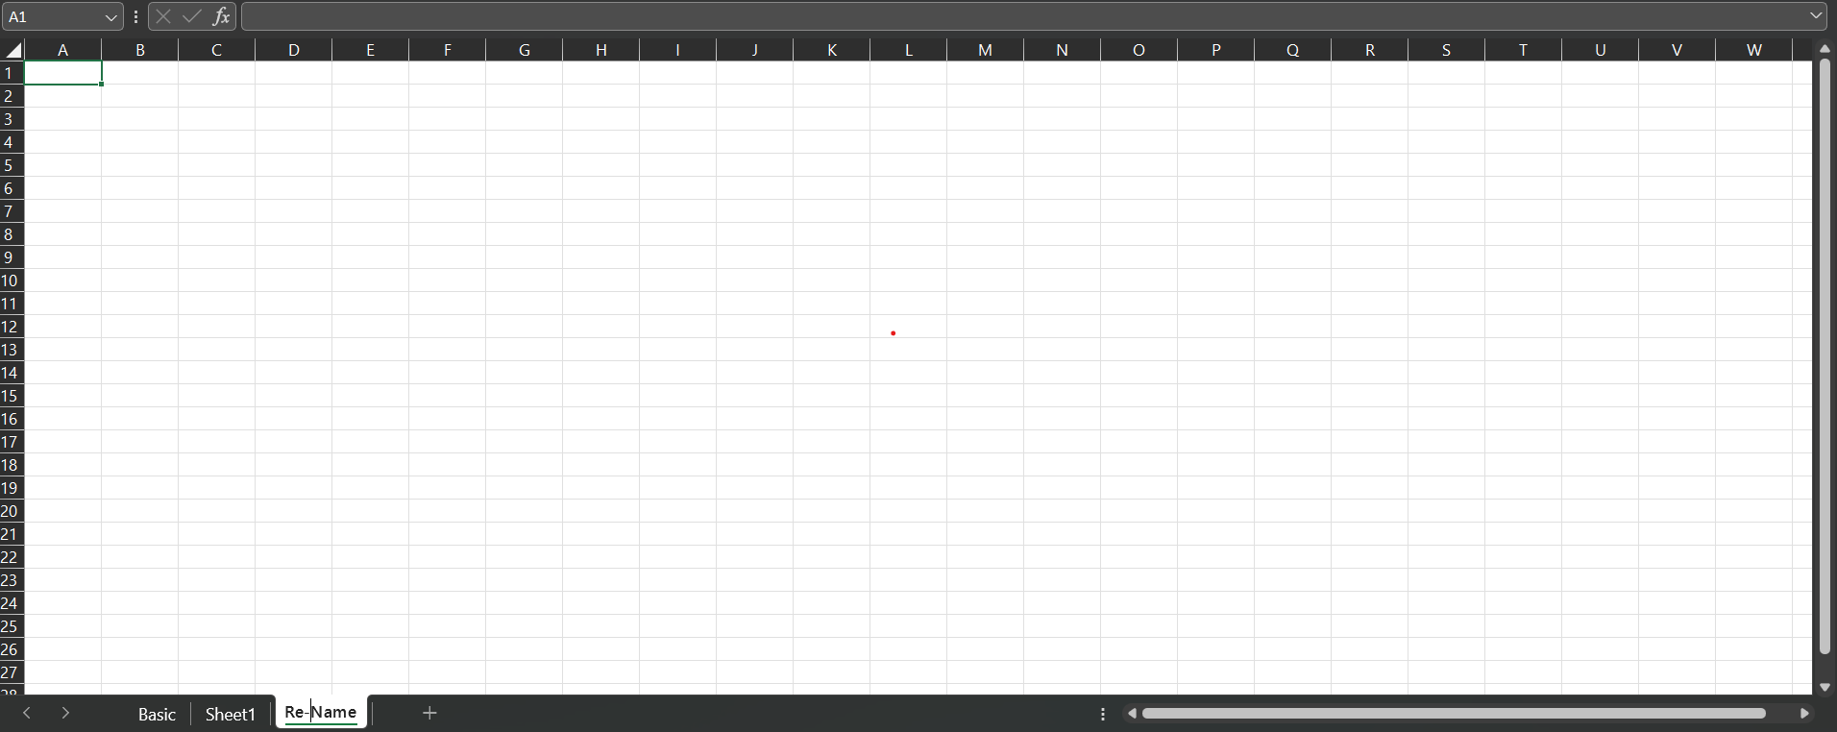
Rename and Multiple sheets

Slide 5
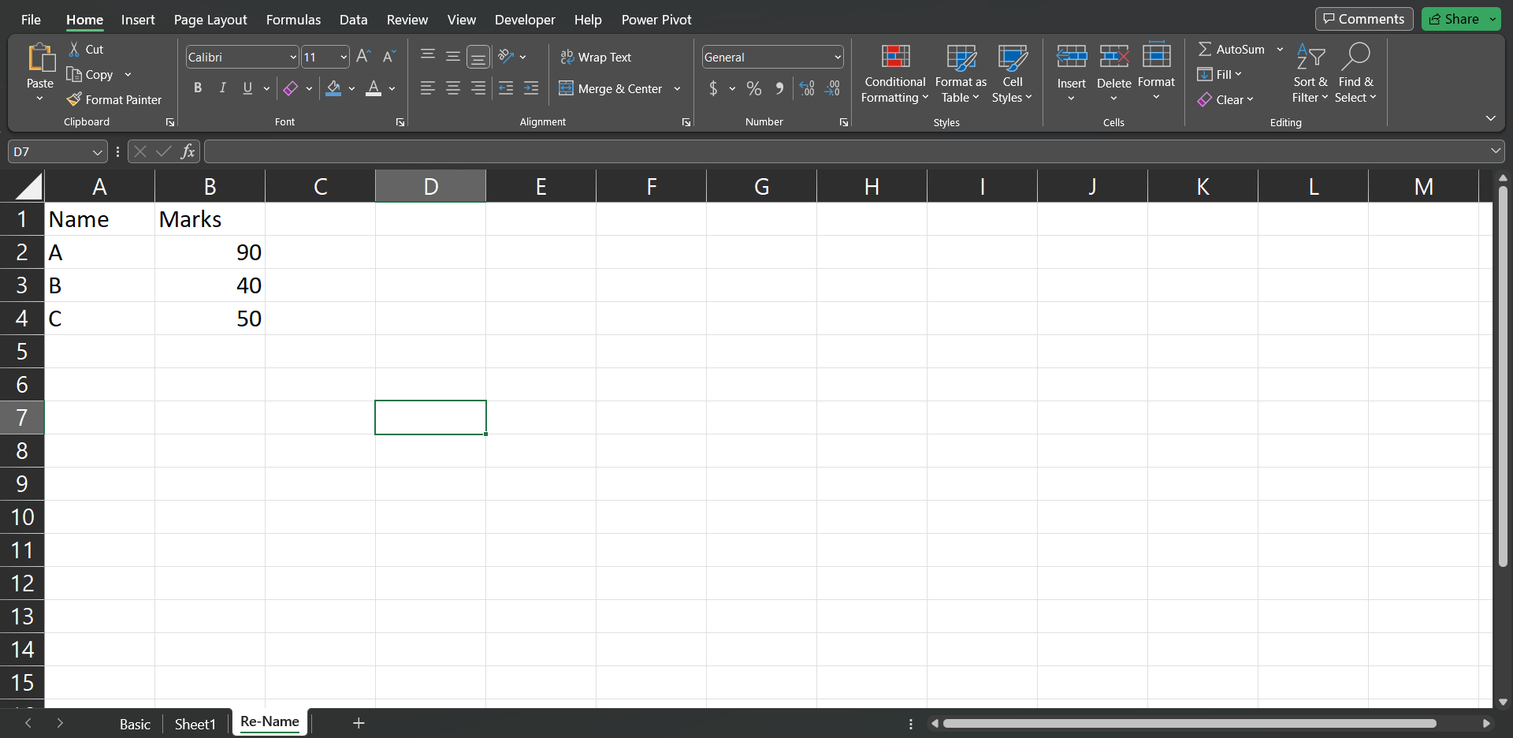
Column and Row Data

Slide 6


Width And height Adjust

Slide 7
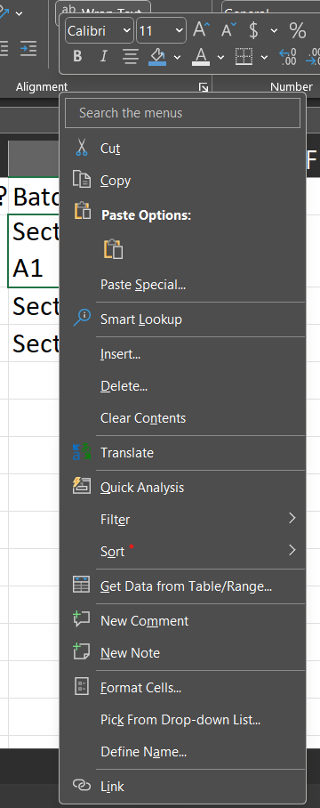
Cell Options

Slide 8
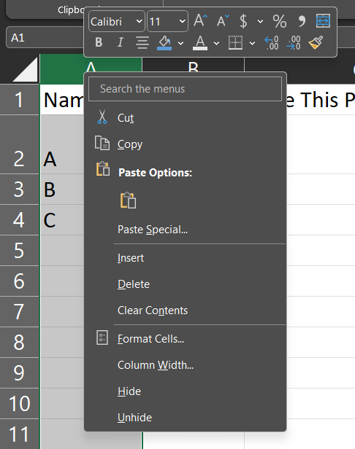
Row options

Slide 9
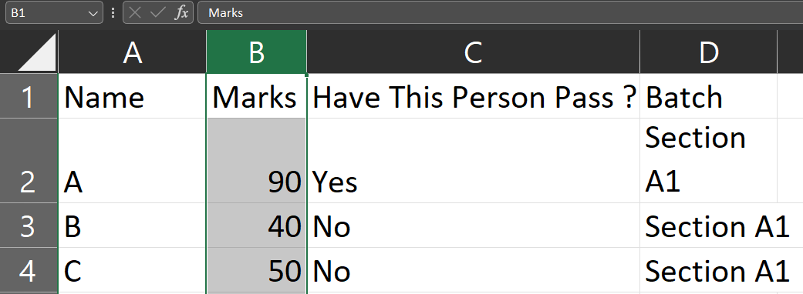

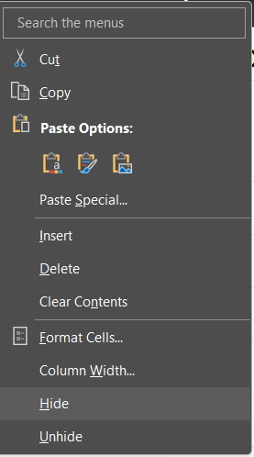
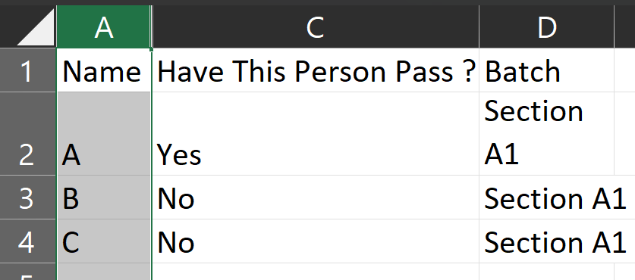
Hide – Unhide
Un-hide
Hide

Slide 10
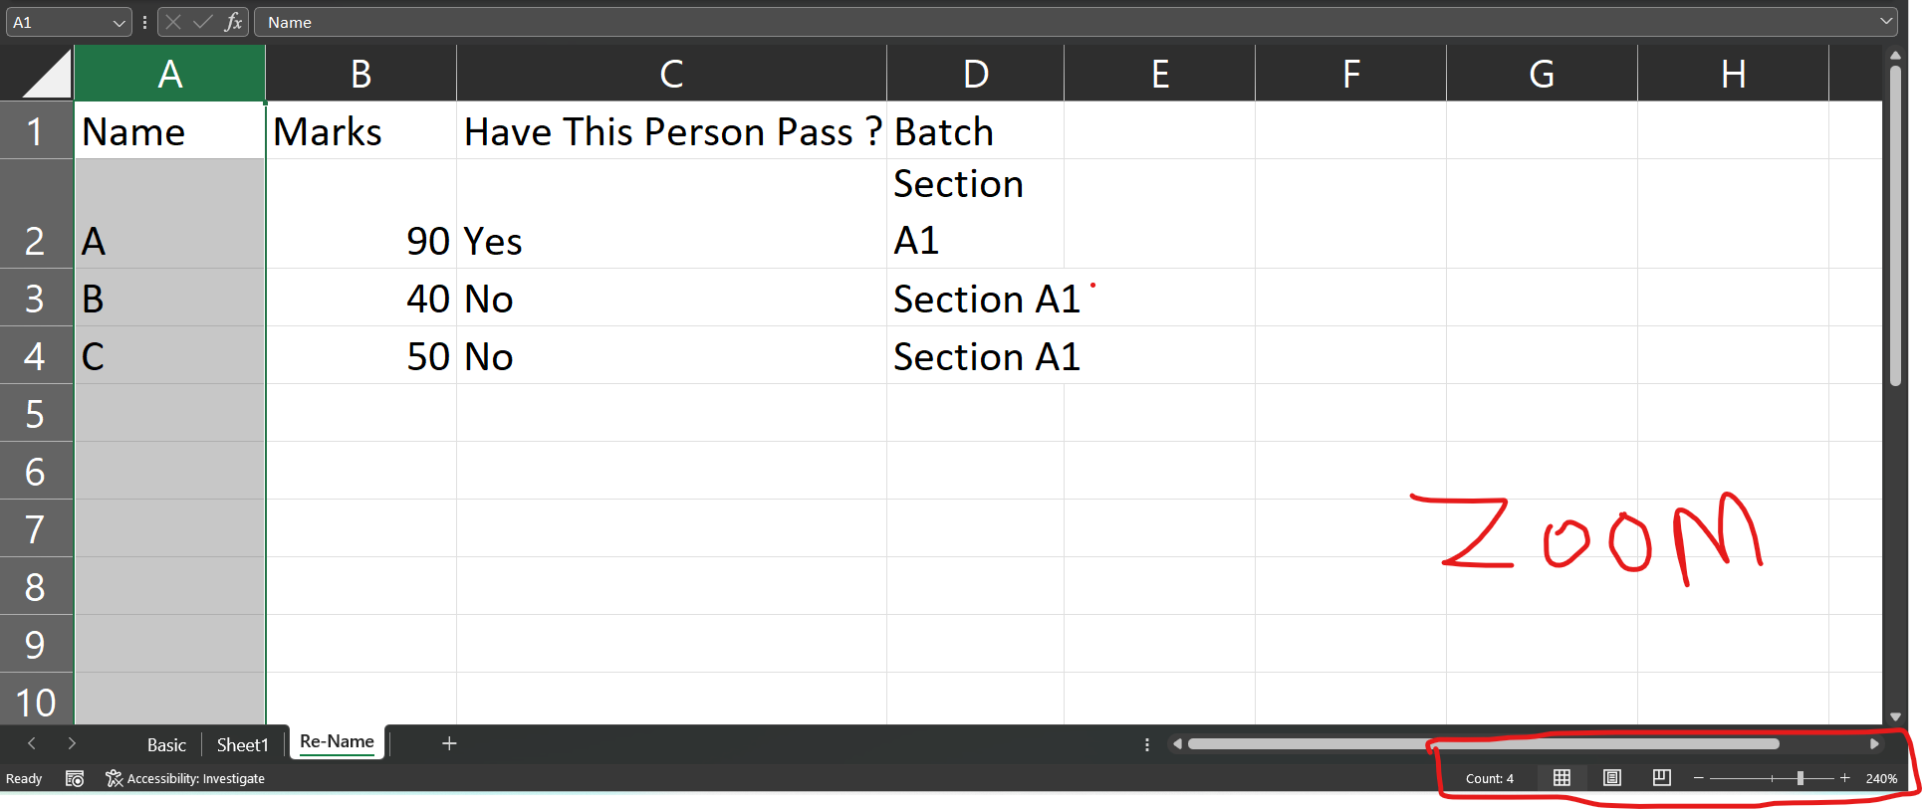
Zoom

Slide 11
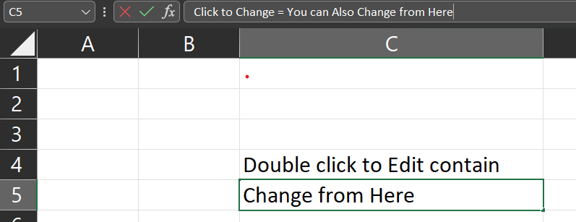
Edit and Change Cell Data

Slide 12
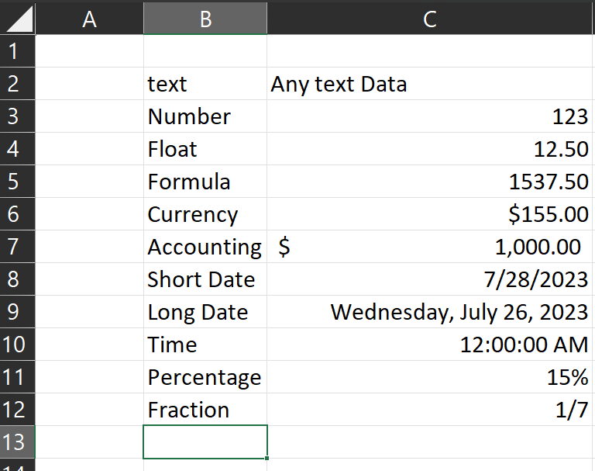
Data Formats

Slide 13
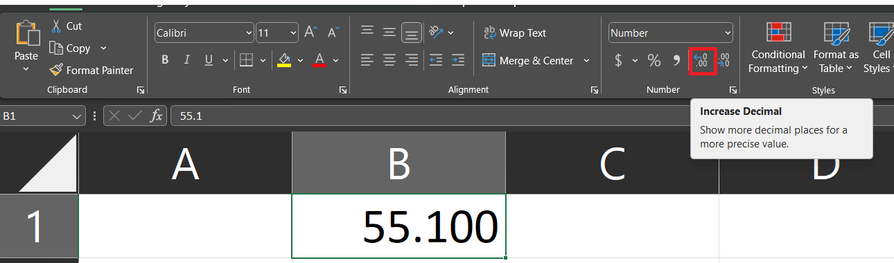

Increase and Decrease Float value

Slide 14






Key Board Short Cut
+
Cut
Paste
All Selection area
Copy
+
Undo
Selection area

